Slide 1
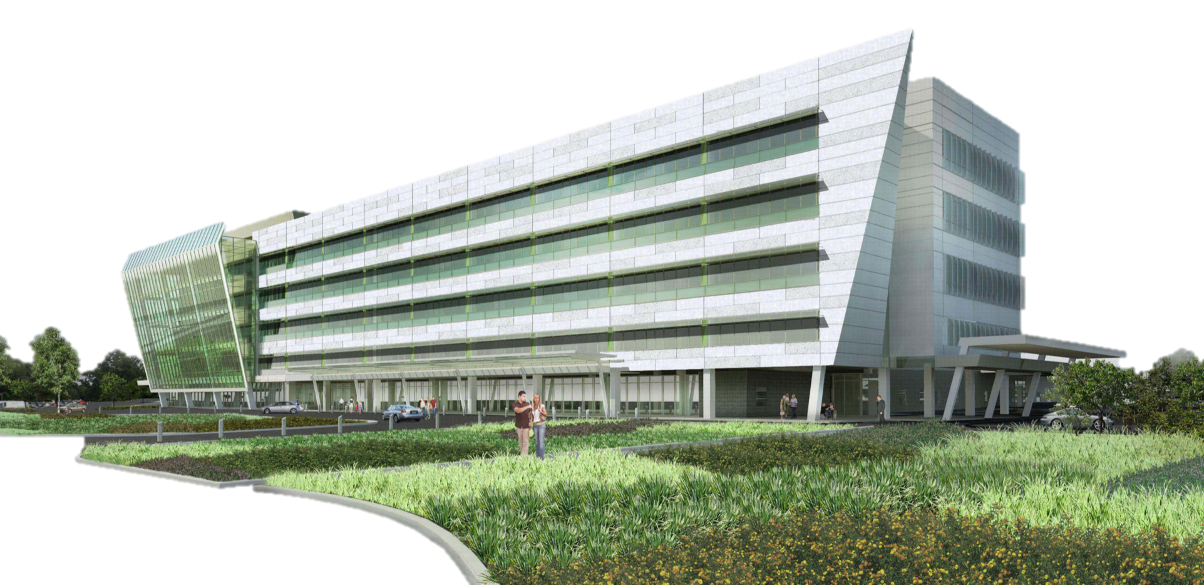
New Regional Medical Center
East Norriton, PA
Brian J. Nahas [Construction Management Option]
Advisor: Dr. Robert Leicht

Slide 2
New Regional Medical Center
East Norriton, PA
implement virtual design and construction processes to identify options & trends in design, construction, and facility management
Brian J. Nahas [Construction Management Option]
Advisor: Dr. Robert Leicht

Slide 3
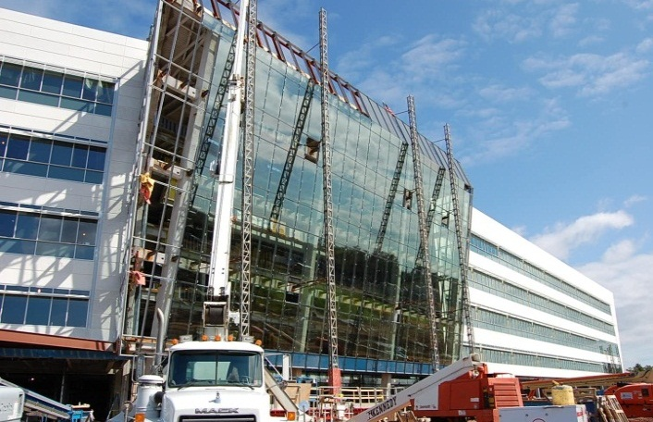
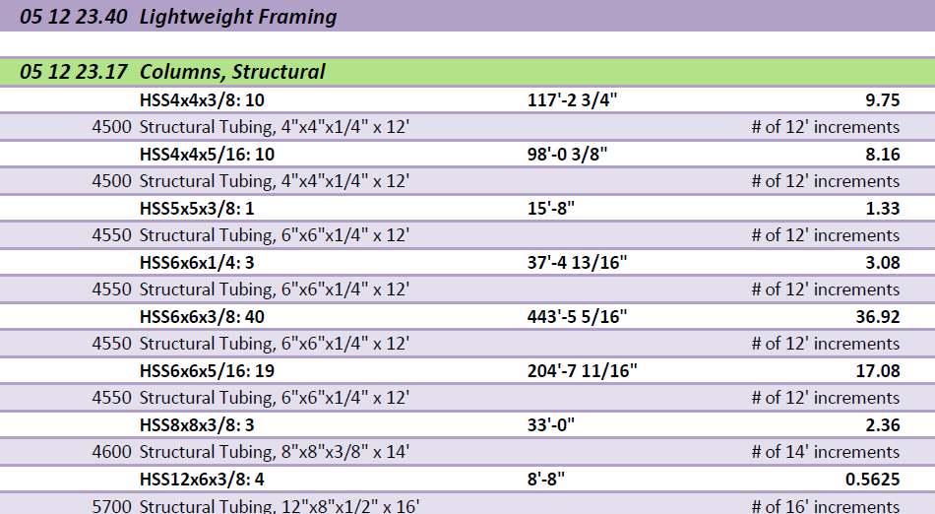
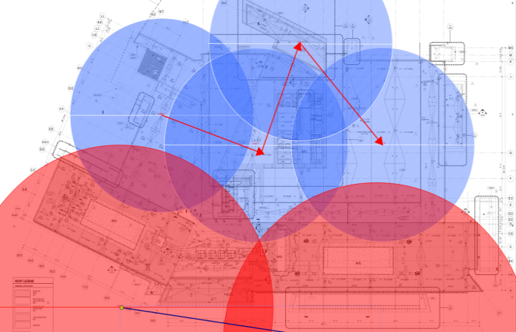
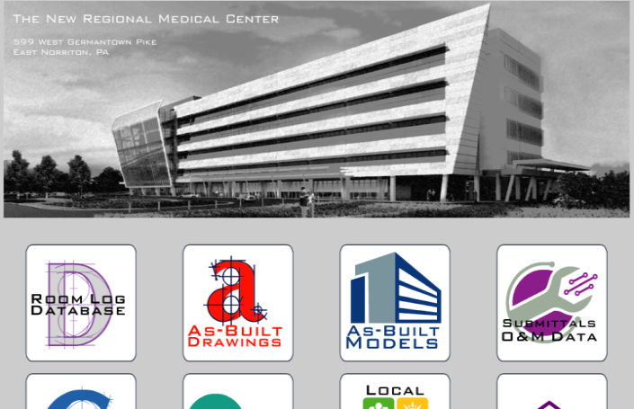
New Regional Medical Center
East Norriton, PA
Project Background
Design
  Atrium Curtain Wall
  Pour Strip System
Preconstruction
  3D Quantity Takeoff & Estimating
Construction
  Steel Trending
  Crane Logistics
Turnover
  Industry Research
  FM Dashboard
  FM Interact
Recommendations

Slide 4
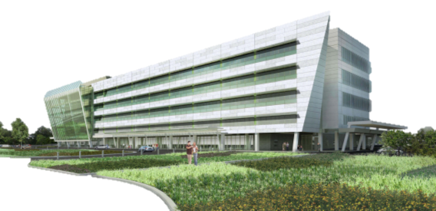



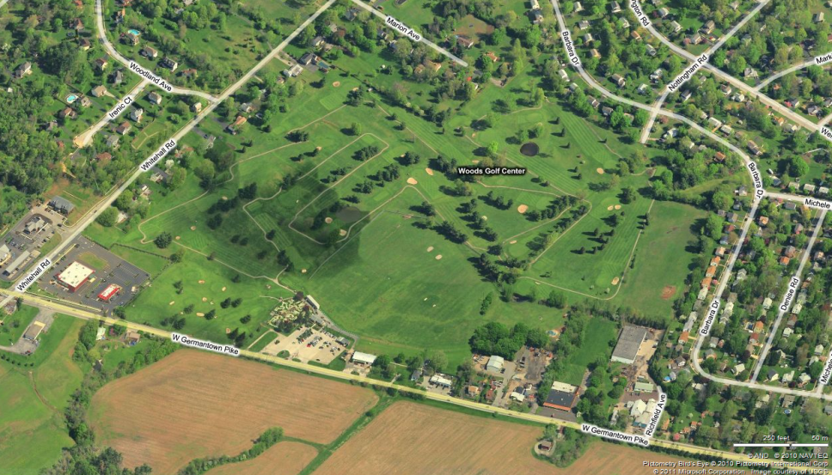
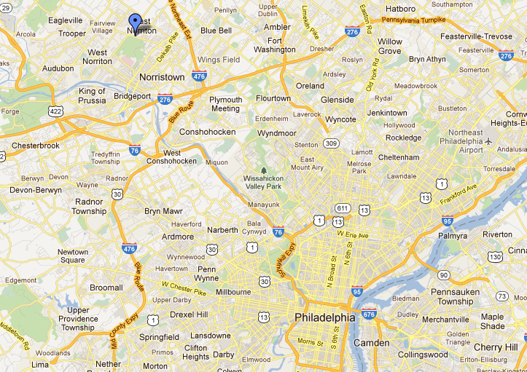
Project Background
New Regional Medical Center
East Norriton, PA
Owner’s Goals
Location
Project Team Members
service to the community
hosting excellence in clinical care
fulfill the void in healthcare in Montgomery County
East Norriton, PA
84-acre former golf course
access to major highways and state roads
Norristown Farm Park
Goal to preserve 1/3 of the campus as green space
Presentation Outline
Project Background
VDC Implementation
  Design
    Atrium Curtain Wall
    Pour Strip System
  Preconstruction
    3D QTO & Estimating
  Construction
    Steel Trending
    Crane Logistics
  Turnover
    FM Documentation
    FM Interact
Recommendations
Acknowledgements
“From its soaring atrium to its advanced imaging services, the center's architectural elegance is matched by top tier patient care capabilities.” Barry Freedman, President & CEO
Hospital Campus
Center City Philadelphia
Brian J. Nahas [Construction Management Option]

Slide 5
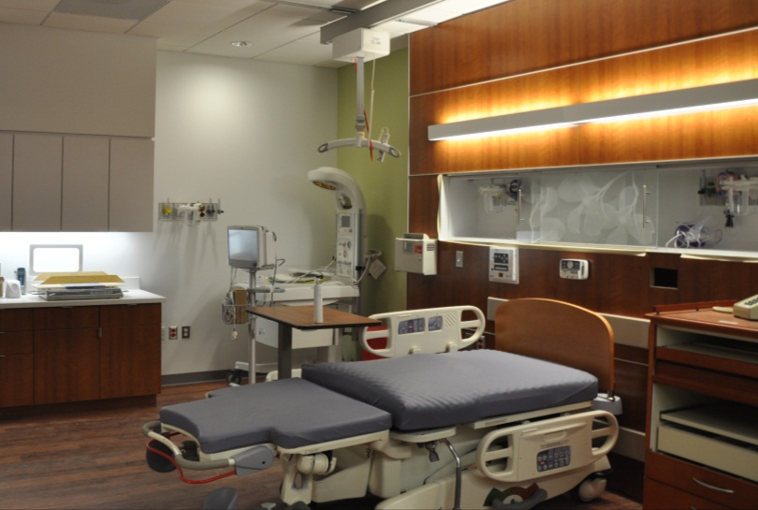
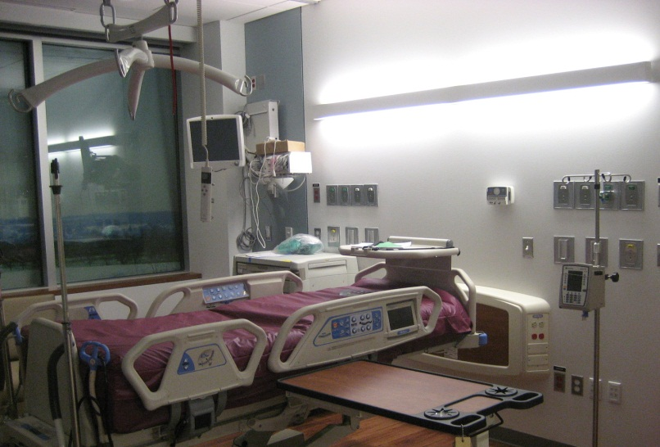
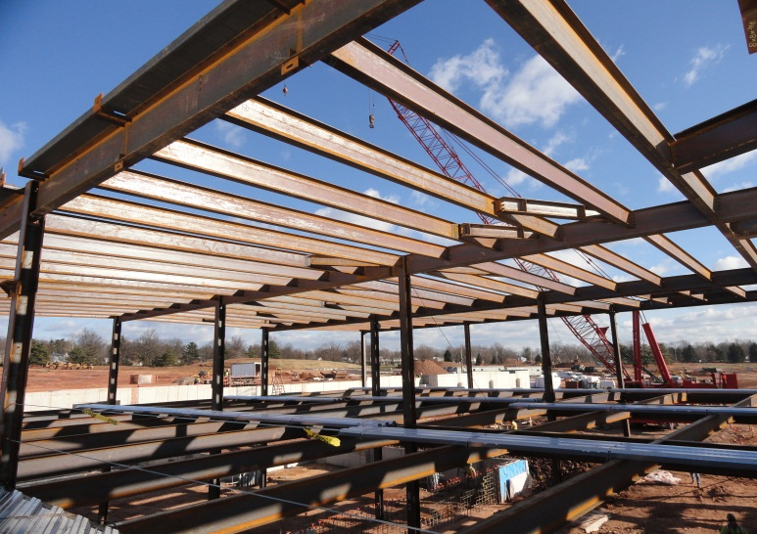
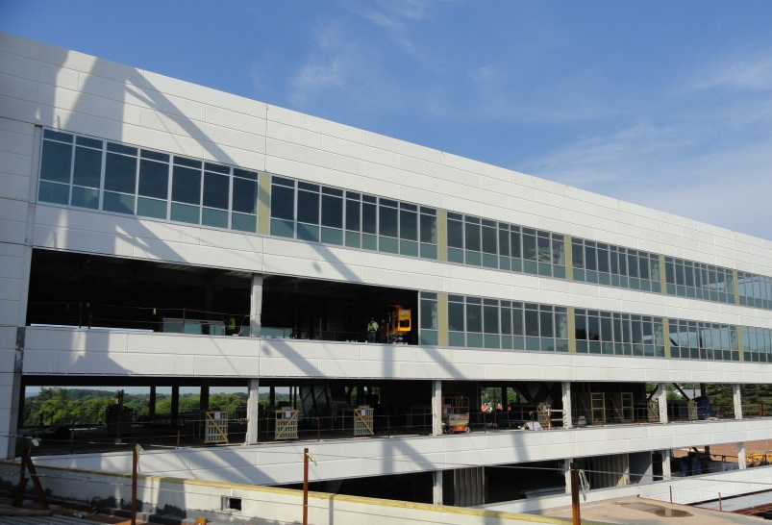
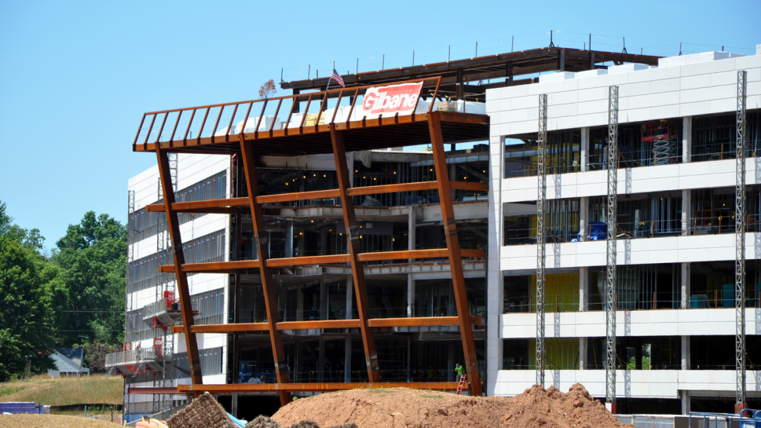
Project Background
New Regional Medical Center
East Norriton, PA
Building Program
Systems & Engineering
Architecture
146 beds
  medical/surgical
  intensive care
  neo-natal
emergency care
trauma center (pending)
LEED certification (pending)
cast-in-place spread footings & foundation walls
structural steel system [30’ x 30’ grid]
  W12 & W14 columns| 1st & 3rd floor splices
  composite decking
composite curtain wall façade
precast panels
glazing units
curtain wall glazing
metal panel
Split-faced masonry block
Presentation Outline
Project Background
VDC Implementation
  Design
    Atrium Curtain Wall
    Pour Strip System
  Preconstruction
    3D QTO & Estimating
  Construction
    Steel Trending
    Crane Logistics
  Turnover
    FM Documentation
    FM Interact
Recommendations
Acknowledgements
Brian J. Nahas [Construction Management Option]

Slide 6
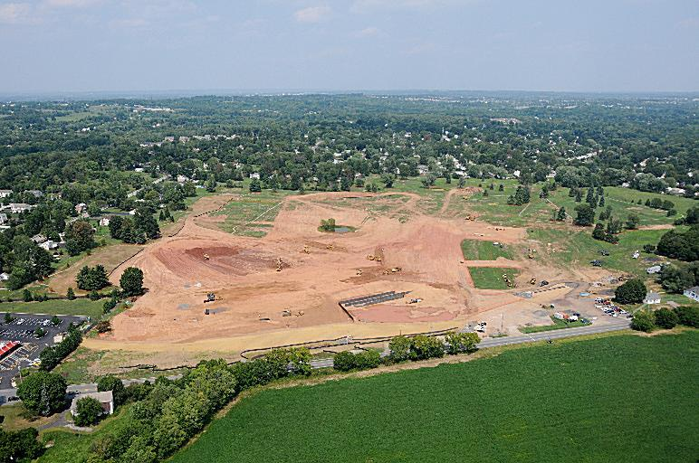
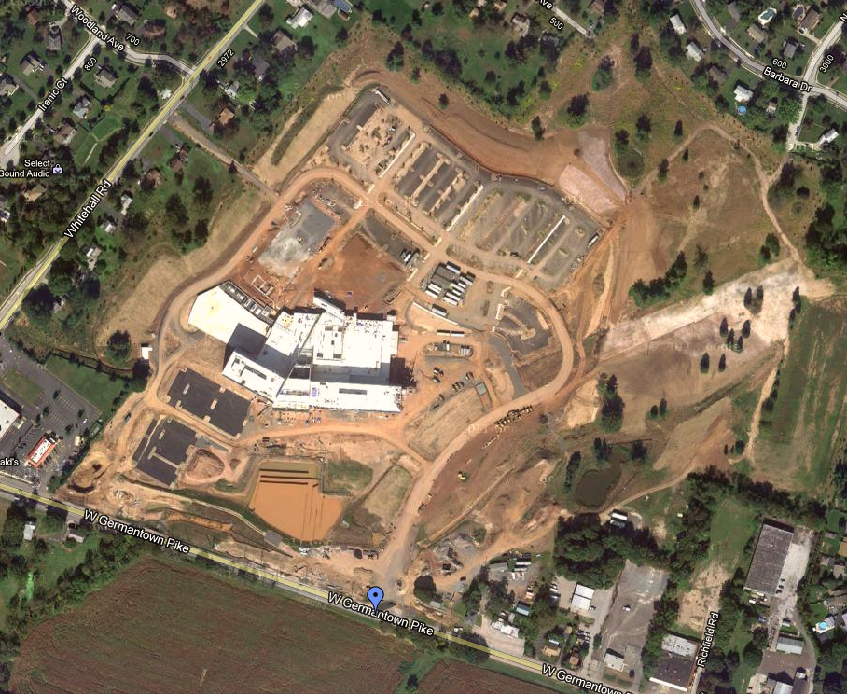
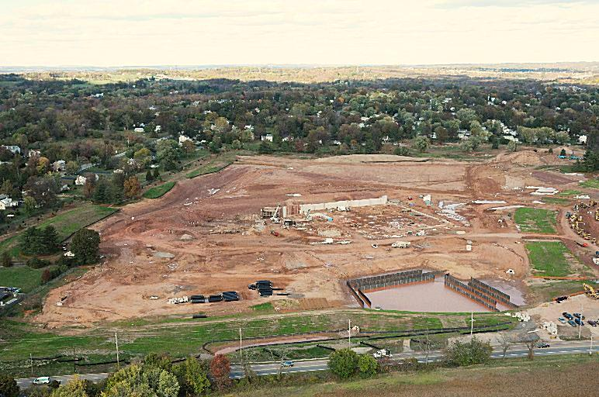
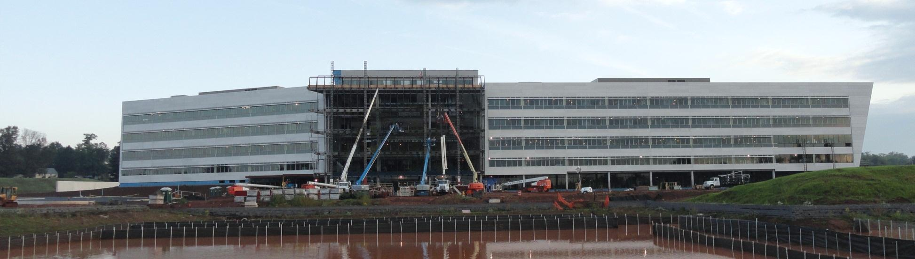
Project Background
New Regional Medical Center
East Norriton, PA
Construction Program & Logistics
$147 million | CM at Risk contract
Presentation Outline
Project Background
VDC Implementation
  Design
    Atrium Curtain Wall
    Pour Strip System
  Preconstruction
    3D QTO & Estimating
  Construction
    Steel Trending
    Crane Logistics
  Turnover
    FM Documentation
    FM Interact
Recommendations
Acknowledgements
Construction Schedule: July 6, 2010 – August 31, 2012
Staff Training: August 8 – October 15, 2012
Opening Day: September 29, 2012
Brian J. Nahas [Construction Management Option]

Slide 7
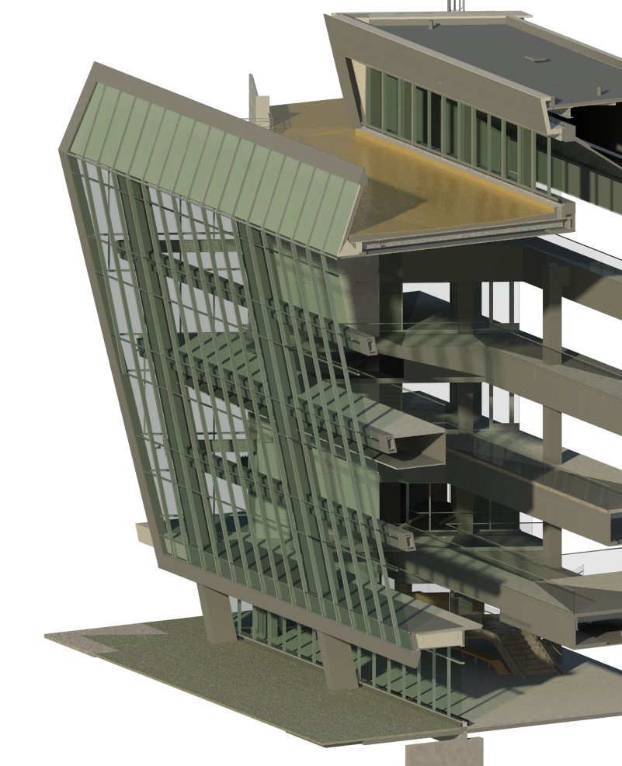
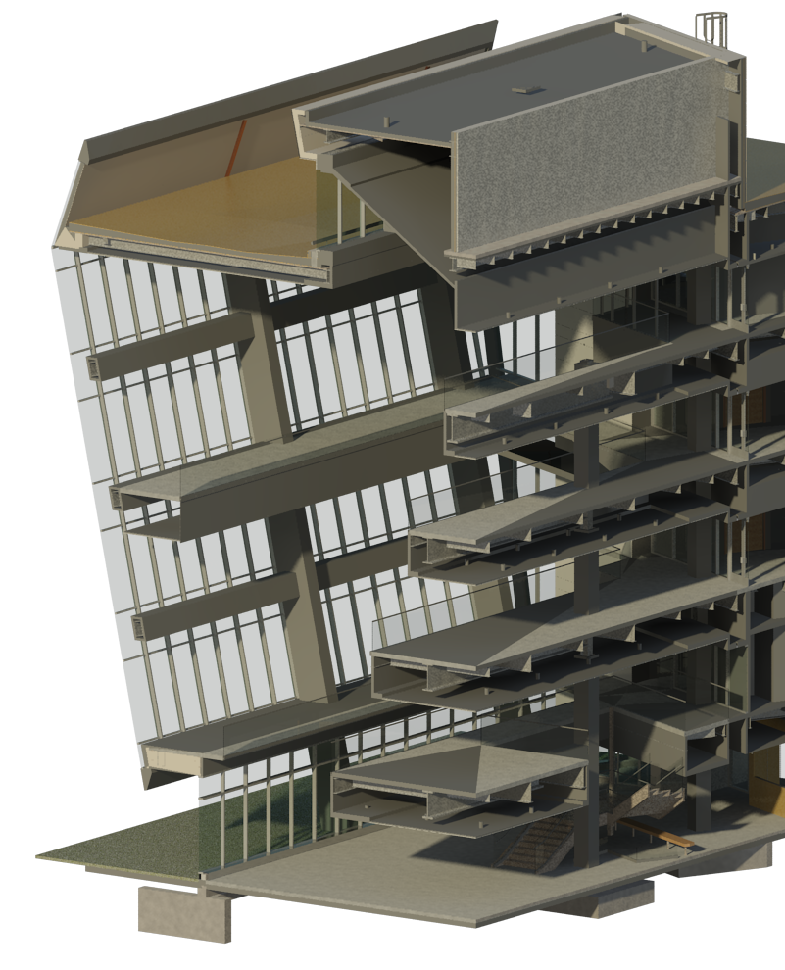
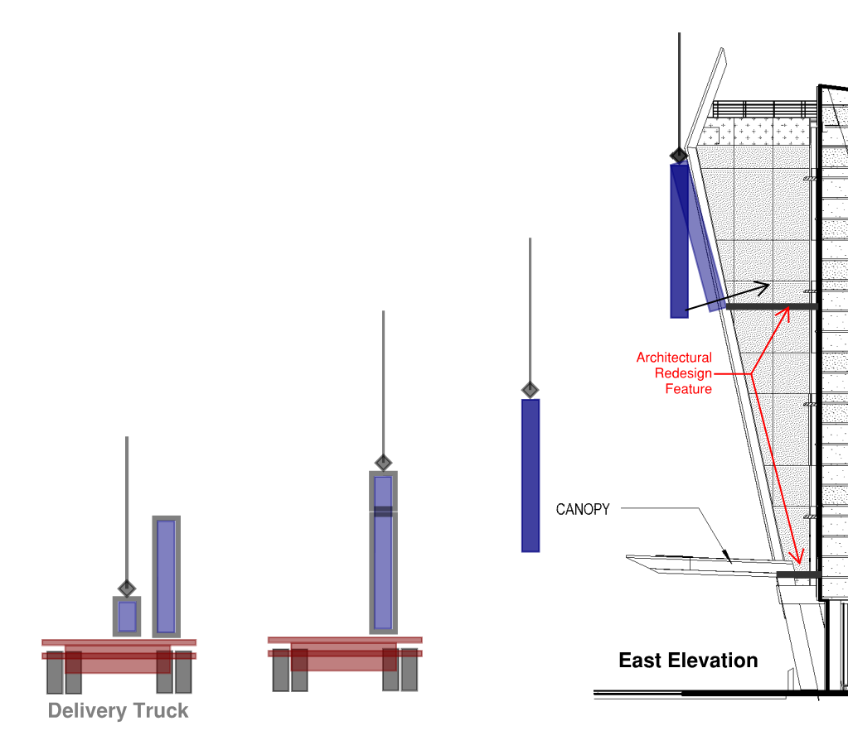
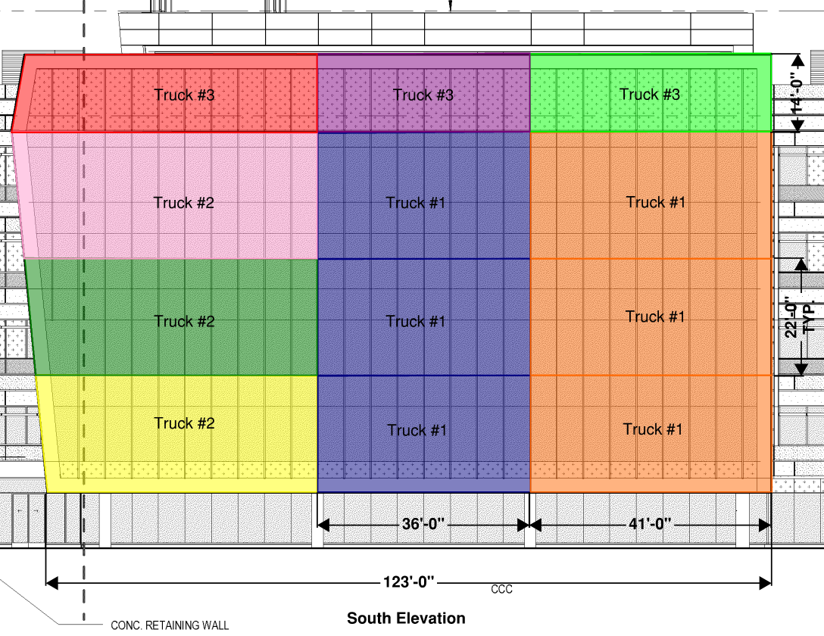
Design
New Regional Medical Center
East Norriton, PA
Architectural Breadth Analysis
improve curtain wall constructability
addition of public space
modularization of glazing panels
Presentation Outline
Project Background
VDC Implementation
  Design
    Atrium Curtain Wall
    Pour Strip System
  Preconstruction
    3D QTO & Estimating
  Construction
    Steel Trending
    Crane Logistics
  Turnover
    FM Documentation
    FM Interact
Recommendations
Acknowledgements
System | Cost
Floor System | $8,450
Structural Steel | $24,338
GWB | $3,280
Finishes | $87,387
Redesign Total | $123,455
Brian J. Nahas [Construction Management Option]

Slide 8
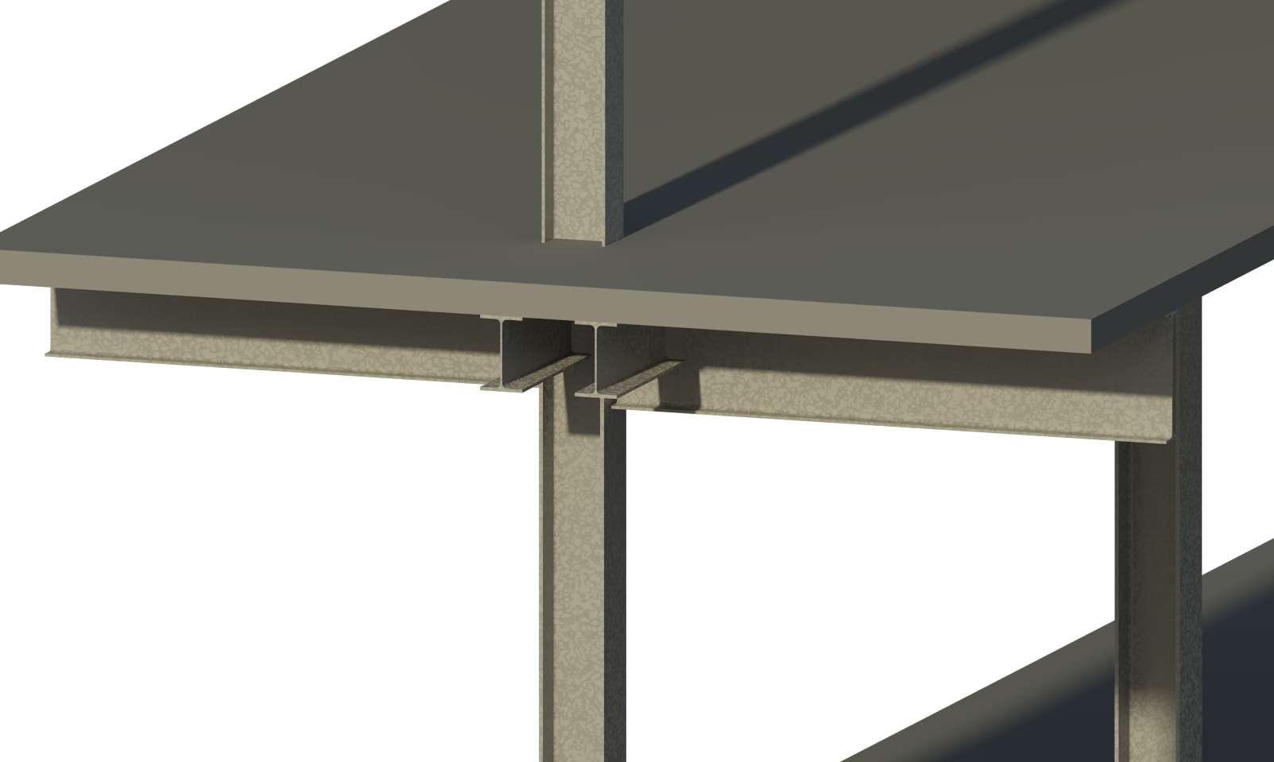
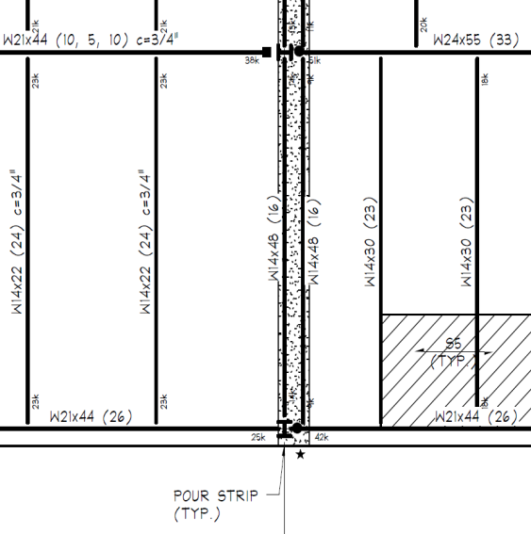
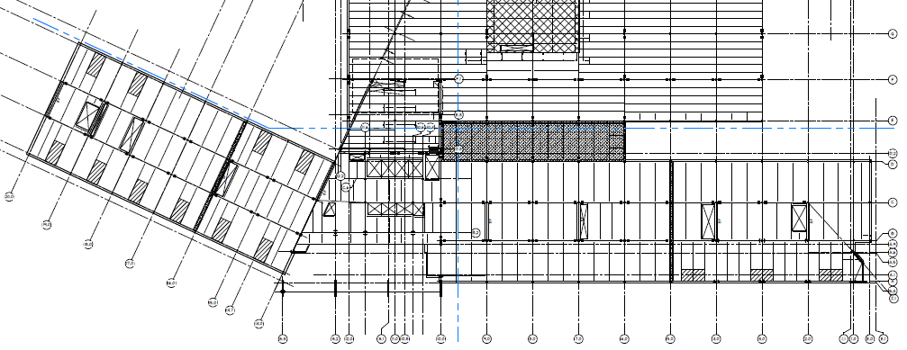
Design
New Regional Medical Center
East Norriton, PA
Structural Breadth Analysis
It is understood that this design decision may create construction issues, and areas for delay. Although this decision does not simplify the AEC’s project approach, it eases the maintenance and lifecycle control of the space… Focus on cost savings.
Richard Montalbano, Project Manager, Einstein Healthcare Network
Existing System:
2 pour stops per floor
125 foot offset from east & west end wall
requires building enclosure & temperature regulation
Presentation Outline
Pour Strip Assembly*
Foundation System | $59,512
Structural Columns | $61,217
Structural Beams | $101,826
Slab on Grade | $684
Slab on Metal Deck | $9,230
Reinforcing | $7,303
Total: | $239,772
Project Background
VDC Implementation
  Design
    Atrium Curtain Wall
    Pour Strip System
  Preconstruction
    3D QTO & Estimating
  Construction
    Steel Trending
    Crane Logistics
  Turnover
    FM Documentation
    FM Interact
Recommendations
Acknowledgements
*quantities derived through Revit design alternates
Brian J. Nahas [Construction Management Option]

Slide 9
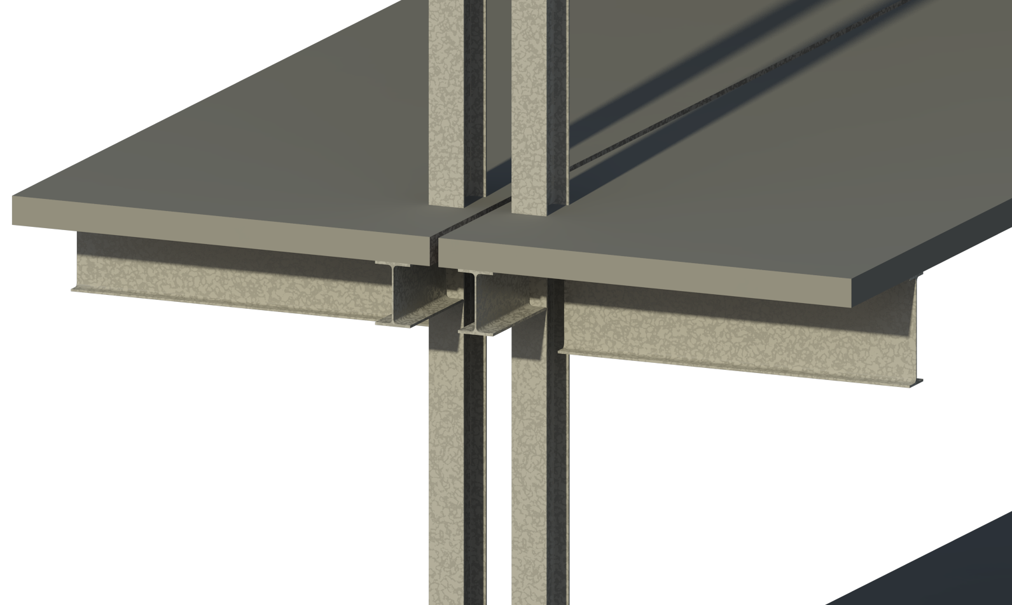
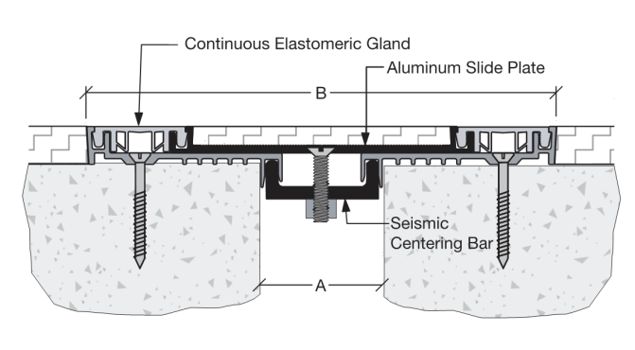
Design
New Regional Medical Center
East Norriton, PA
Structural Breadth Analysis
Method:
calculate design tolerance & joint gap
size structural steel members
  tributary area
  load calculation
  locate splices
  design member per AISC Table 4-1
size spread footings per column case
model redesign
export quantities for estimate
Outcome:
2 expansion joints per floor
2” structural gap
use W12 x 50 & W12 x 40
13’ x 13’ x 30”
  #7 bars each way 6” oc
13.5’ x 13.5’ x 30”
  #7 bars each way 6” oc
Presentation Outline
Expansion Joint Assembly |  | Diff.
Foundation System | $32,758 | -45%
Structural Columns | $60,671 | -1%
Structural Beams | $101,826 | -
Slab on Grade | $684 | -
Slab on Metal Deck | $8,552 | +7%
Reinforcing | $8,613 | +18%
Expansion Joint Covers | $40,289 | +100%
Misc. Steel Angle | $44,177 | +100%
Total: | $297,570 | +24%
Project Background
VDC Implementation
  Design
    Atrium Curtain Wall
    Pour Strip System
  Preconstruction
    3D QTO & Estimating
  Construction
    Steel Trending
    Crane Logistics
  Turnover
    FM Documentation
    FM Interact
Recommendations
Acknowledgements
Brian J. Nahas [Construction Management Option]

Slide 10
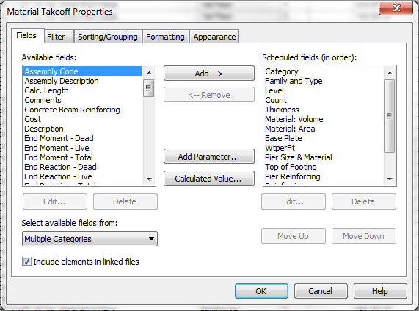
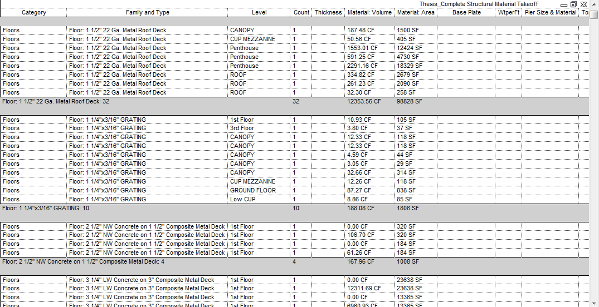
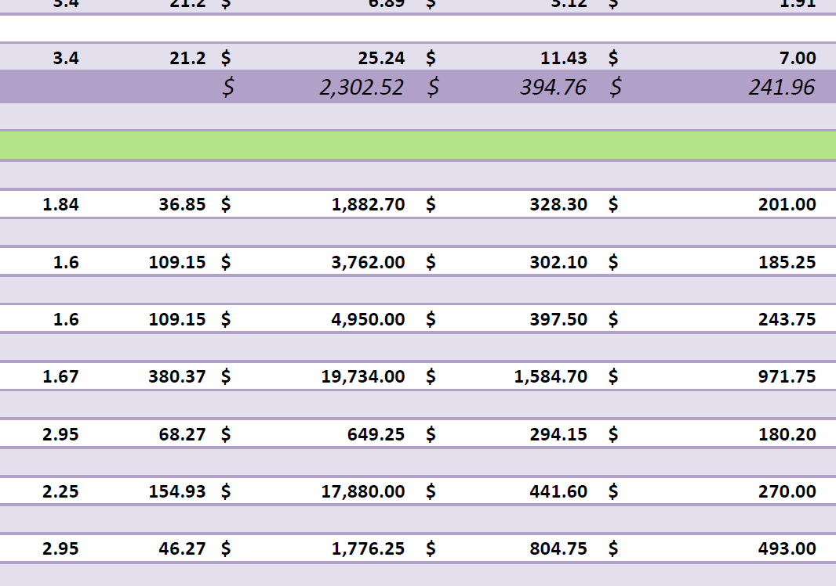
Preconstruction
New Regional Medical Center
East Norriton, PA
3D Quantity Takeoff
Model Estimating
Method:
create schedule of materials
export to excel
reference cost database
include non-modeled elements
produce estimate
Presentation Outline
Project Background
VDC Implementation
  Design
    Atrium Curtain Wall
    Pour Strip System
  Preconstruction
    3D QTO & Estimating
  Construction
    Steel Trending
    Crane Logistics
  Turnover
    FM Documentation
    FM Interact
Recommendations
Acknowledgements
Outcome:
CIP Concrete: +10.7% from as-built costs
Structural Steel: +0.5% from as-built costs
7.5% improvement on Gilbane’s method
Brian J. Nahas [Construction Management Option]

Slide 11
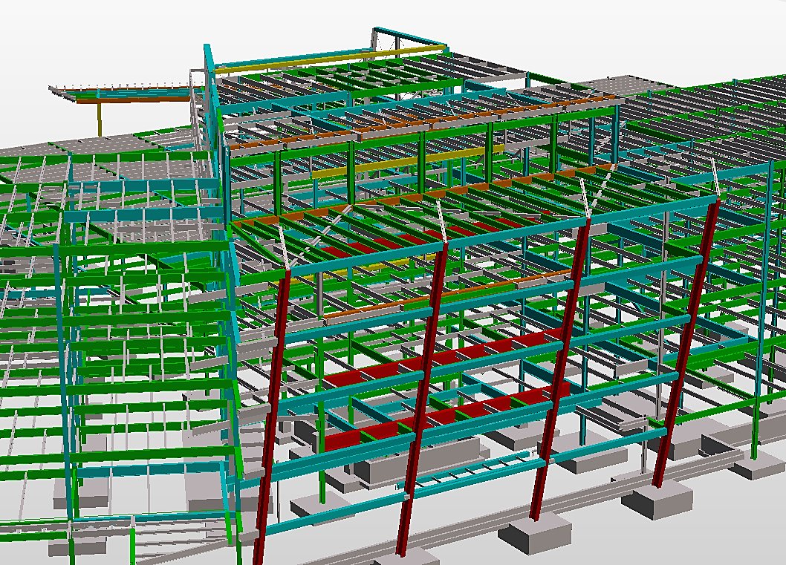
Construction
New Regional Medical Center
East Norriton, PA
Steel Trending
Presentation Outline
Project Background
VDC Implementation
  Design
    Atrium Curtain Wall
    Pour Strip System
  Preconstruction
    3D QTO & Estimating
  Construction
    Steel Trending
    Crane Logistics
  Turnover
    FM Documentation
    FM Interact
Recommendations
Acknowledgements
At each exchange point a thorough understanding is needed of who is involved, what software is involved, and what data needs to be exchanged (or can be exchanged) and what the data will be used for.”
Luke Faulkner, AISC Director of Information Technology Initiatives
Brian J. Nahas [Construction Management Option]

Slide 12
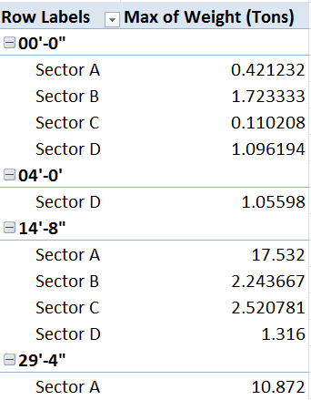
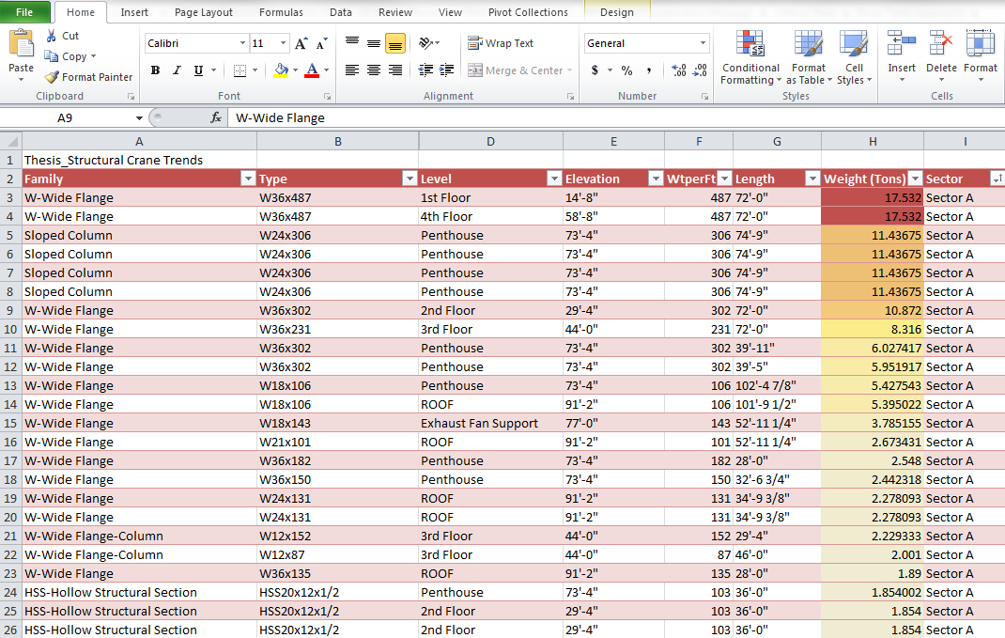
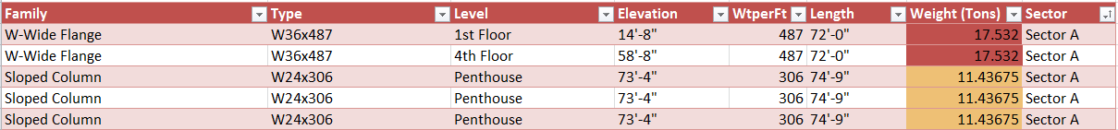
Construction
New Regional Medical Center
East Norriton, PA
Steel Trending
Column Splice [Lift 1]
Column Splice [Lift 2]
Column Splice [Lift 3]
Presentation Outline
Revit data to Excel Pivot Table & Chart
Project Background
VDC Implementation
  Design
    Atrium Curtain Wall
    Pour Strip System
  Preconstruction
    3D QTO & Estimating
  Construction
    Steel Trending
    Crane Logistics
  Turnover
    FM Documentation
    FM Interact
Recommendations
Acknowledgements
Brian J. Nahas [Construction Management Option]

Slide 13
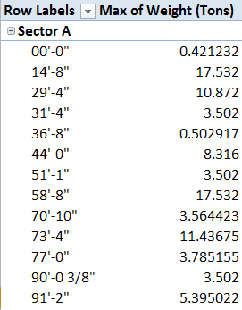
Construction
New Regional Medical Center
East Norriton, PA
Steel Trending
Revit data to Excel Pivot Table & Chart
Presentation Outline
Project Background
VDC Implementation
  Design
    Atrium Curtain Wall
    Pour Strip System
  Preconstruction
    3D QTO & Estimating
  Construction
    Steel Trending
    Crane Logistics
  Turnover
    FM Documentation
    FM Interact
Recommendations
Acknowledgements
Brian J. Nahas [Construction Management Option]

Slide 14
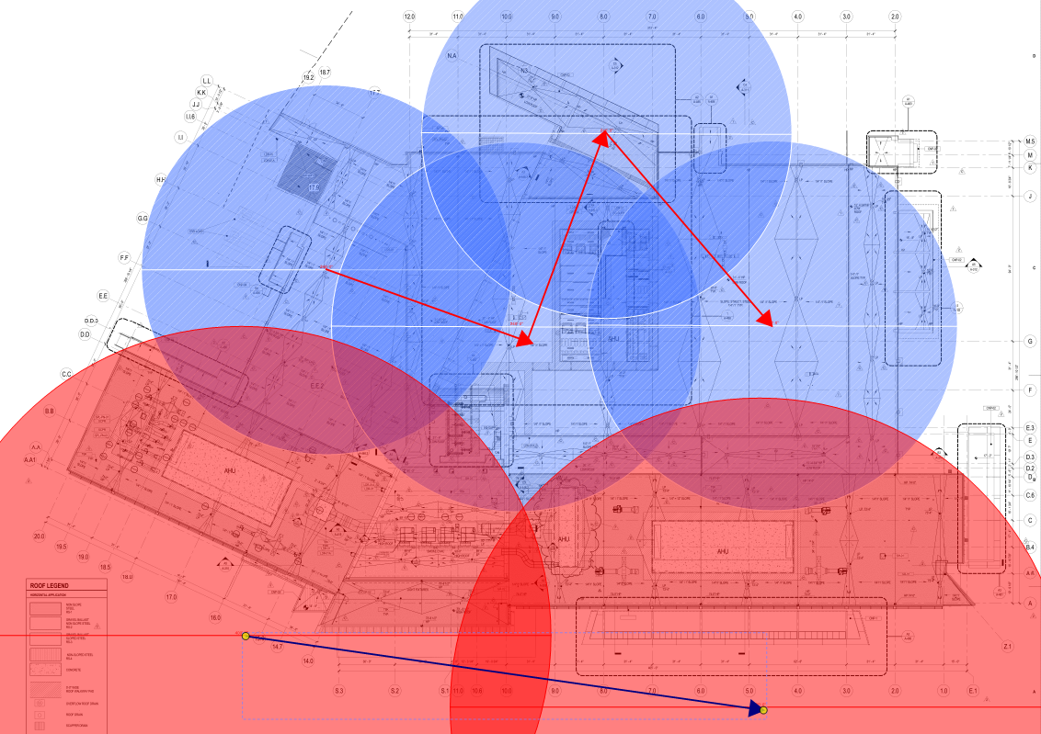
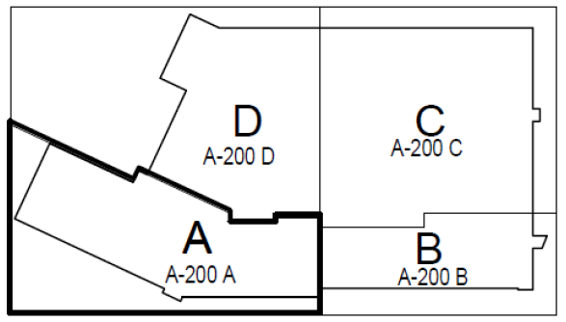
Construction
New Regional Medical Center
East Norriton, PA
Crane Logistics
300 Ton Lattice Crane
Mobilization & Demobilization Costs: $9,000 x 2 = $18,000
Rental Costs: $20,000 x 18 weeks = $360,000
TOTAL: $378,000
300 Ton Lattice Crane & 110 Ton Mobile Crane
Mobilization & Demobilization Costs: $9,000 x 2 + $3,400 x 2 = $24,800
Rental Costs: $20,000 x 15 weeks + $5,840 x 3 weeks = $317,520
TOTAL: $342,320
Results:
2 week schedule reduction: $280,047 [general conditions]
Crane rental: $35,680
Total Project Savings: $315,727
Presentation Outline
110 Ton Mobile Crane
Project Background
VDC Implementation
  Design
    Atrium Curtain Wall
    Pour Strip System
  Preconstruction
    3D QTO & Estimating
  Construction
    Steel Trending
    Crane Logistics
  Turnover
    FM Documentation
    FM Interact
Recommendations
Acknowledgements
300 Ton
Lattice Crane
Brian J. Nahas [Construction Management Option]

Slide 15
Turnover
New Regional Medical Center
East Norriton, PA
Industry Research
Current Information Technology Use
Owner Interview
01 | BIM | 02 | iPads | 03 | Collaboration Environment
04 | Online Project Documents | 05 | 3D CAD | 06 | Mobile Tools & Devices
Current Use
  Paper Plan Room
  Outdated As-Built information
Desired Use
  Room Data Log
  As-Built Drawings
  Submittal Log
Presentation Outline
Project Background
VDC Implementation
  Design
    Atrium Curtain Wall
    Pour Strip System
  Preconstruction
    3D QTO & Estimating
  Construction
    Steel Trending
    Crane Logistics
  Turnover
    FM Documentation
    FM Interact
Recommendations
Acknowledgements
Desired Information Technology
01 | Cheaper, Better Software | 02 | Data Integrations (BIM) | 03 | Online Collaboration
04 | Mobile Hardware | 05 | Cloud Storage & Tools | 06 | Linked & Live Project Controls
“The words that came up most often were ‘cheaper,’ ‘simpler,’ streamlined,’ ‘user-friendly,’ ‘interoperable,’ and ‘integrated’.”
Tom Sawyer, Engineering News-Record
Brian J. Nahas [Construction Management Option]

Slide 16

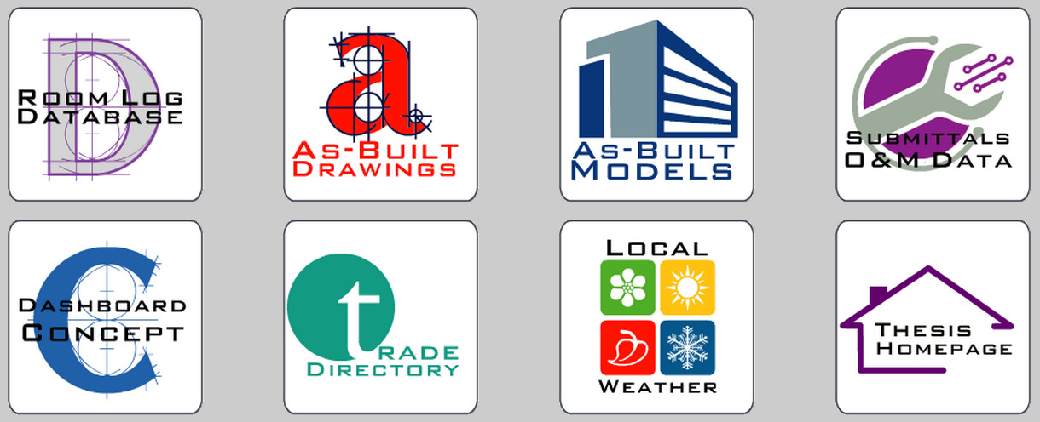
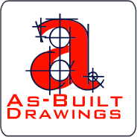

Turnover
New Regional Medical Center
East Norriton, PA
FM Dashboard
  Room Log
  Direct access to equipment files
  Construction & As-built Photographs
  As-Built Drawings
  PDF Digital Set
  Hyperlinked details
  Submittal / O&M
  Material Submittal Information
  Equipment & Room Locations
“A FM document interface should not consist of a series of internet pages built around a specific Attribute; it should consist of an interface which reads a database of relative information, data, and asset.”
Dr. Craig Dubler, Office of the Physical Plant [PSU]
Presentation Outline
Project Background
VDC Implementation
  Design
    Atrium Curtain Wall
    Pour Strip System
  Preconstruction
    3D QTO & Estimating
  Construction
    Steel Trending
    Crane Logistics
  Turnover
    FM Documentation
    FM Interact
Recommendations
Acknowledgements
Brian J. Nahas [Construction Management Option]

Slide 17
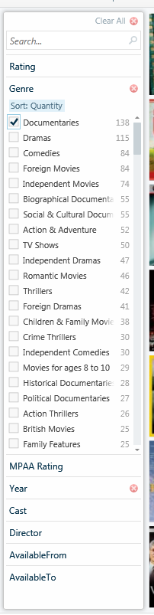
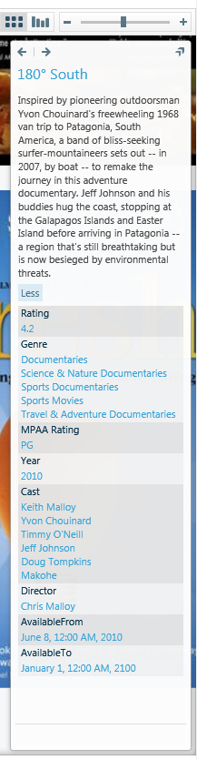
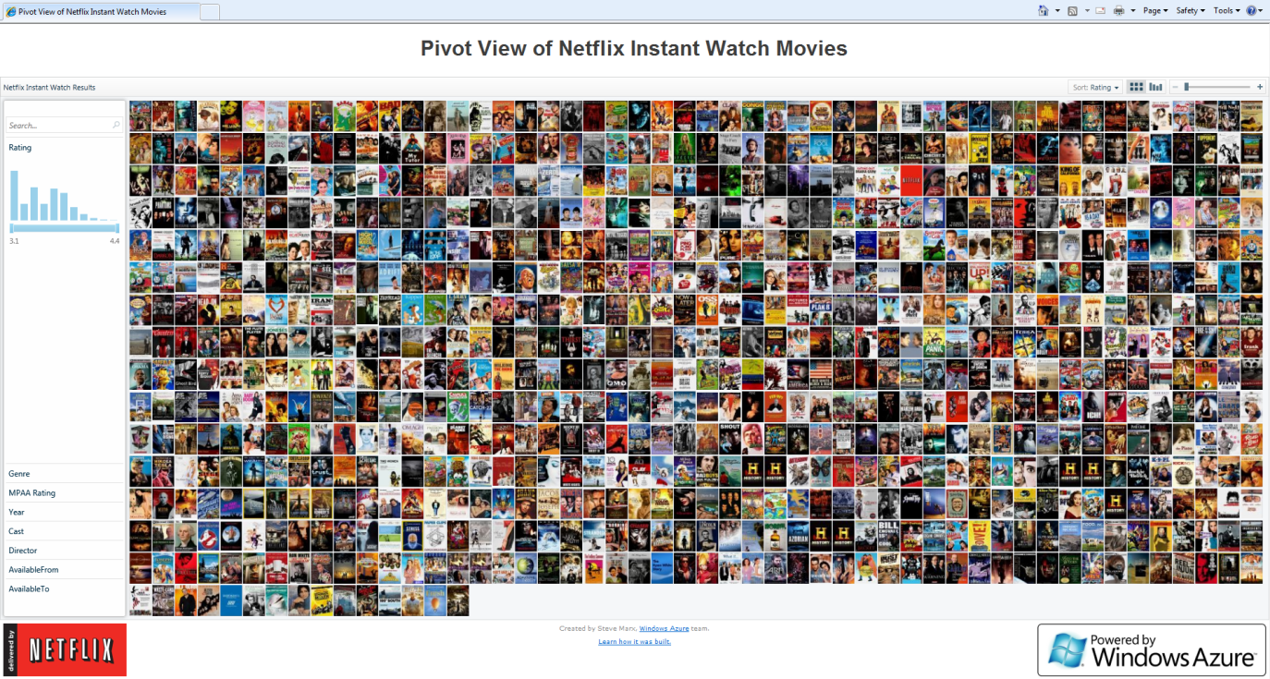

Turnover
New Regional Medical Center
East Norriton, PA
Filter Parameter | Document Data & Relationships
System | Construction Photos, Submittals, RFI’s, Contract Drawings, Design Model, As-Built Model, Equip. Data Sheet
Zoom Format | JPG, TIFF
Link to Original File | JPG, PDF, RVT, DWG, NWD, DOC, XLS, SKP, Hyperlink, Other
Document Name | Individual Description
Campus | East Norriton
Facility Name | New Regional Medical Center
Building Sector | A, B, C, D, Central Utility, Site
Floor Level | Ground Level, 1, 2, 3, 4, Roof
Room Number | ####
Date Added to Database | YYYY-MM-DD
Model/Drawing | Yes, No
CSI Discipline | ## - Title
Bid Package # | BP ##
Trade Contractor | Company Name
Trade Contact | Contact – linked to email address
Design Team | Company Name
Design Contact | Contact – linked to email address
Construction Manager | Company Name
Construction Contact | Contact – linked to email address
Asset Management | Hyperlink to external software/file
FM Interact
Presentation Outline
Microsoft Silverlight – Pivot Viewer
Project Background
VDC Implementation
  Design
    Atrium Curtain Wall
    Pour Strip System
  Preconstruction
    3D QTO & Estimating
  Construction
    Steel Trending
    Crane Logistics
  Turnover
    FM Documentation
    FM Interact
Recommendations
Acknowledgements
Brian J. Nahas [Construction Management Option]

Slide 18
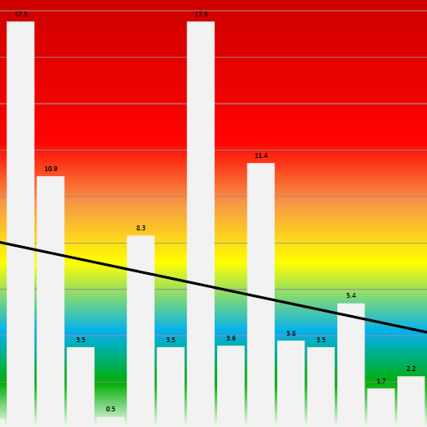
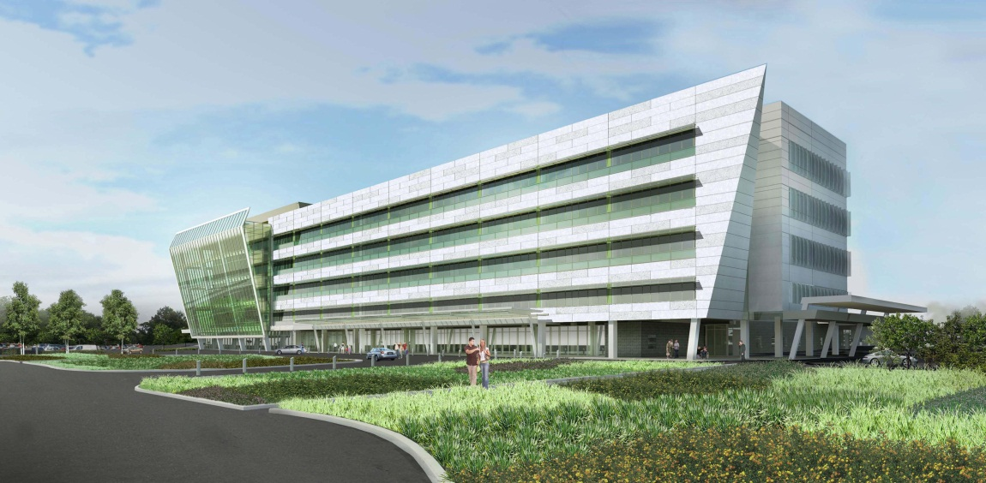
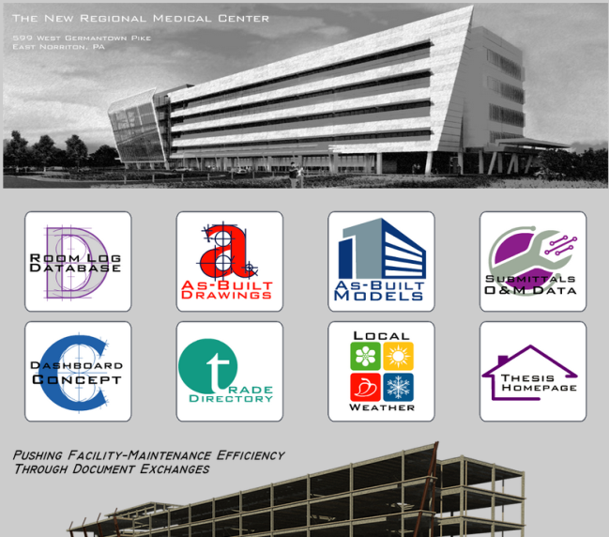
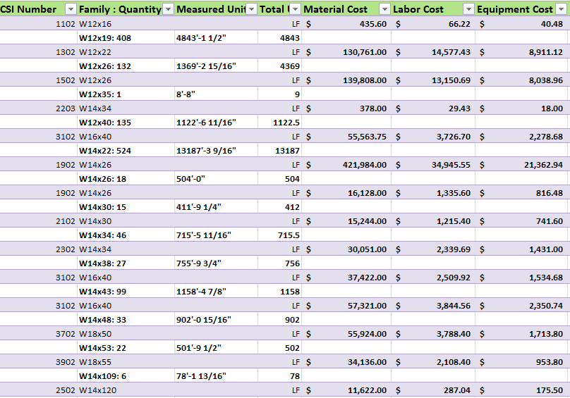
Recommendations
New Regional Medical Center
East Norriton, PA
Design
Construction
Atrium & Pour Strip Redesign
Benefit to NRMC: NO
Benefit to the Industry: YES
Development: Externally
Steel Trending
Benefit to NRMC: YES
Benefit to the Industry: YES
Development: Internally
Presentation Outline
Project Background
VDC Implementation
  Design
    Atrium Curtain Wall
    Pour Strip System
  Preconstruction
    3D QTO & Estimating
  Construction
    Steel Trending
    Crane Logistics
  Turnover
    FM Documentation
    FM Interact
Recommendations
Acknowledgements
Preconstruction
Turnover
3D Quantity Takeoff & Estimate
Benefit to NRMC: YES
Benefit to the Industry: YES
Development: Internally
Document Management
Benefit to NRMC: YES
Benefit to the Industry: YES
Development: Internally & Externally
Brian J. Nahas [Construction Management Option]

Slide 19


Acknowledgements
New Regional Medical Center
East Norriton, PA
Industry Acknowledgements
Special Thanks
Lessons Learned
Richard Montalbano & the Facility Management Staff at Albert Einstein Healthcare Network
Andrew Packer & Jerry Shaheen at Gilbane Building Company
Gene Hodge, Jason Brown, Nicholas Kantor, & Michal Wojtak at Mortenson Construction
Dr. Craig Dubler & the Facility Management Staff at Penn State’s Office of Physical Plant
PACE Industry Members
My Family & Friends
Presentation Outline
VDC implementation goes beyond the utilization of models and design software.
Additional insight into design data produces a stronger understanding of construction and FM usage.
Project Background
VDC Implementation
  Design
    Atrium Curtain Wall
    Pour Strip System
  Preconstruction
    3D QTO & Estimating
  Construction
    Steel Trending
    Crane Logistics
  Turnover
    FM Documentation
    FM Interact
Recommendations
Acknowledgements
Brian J. Nahas [Construction Management Option]

Slide 20
New Regional Medical Center
East Norriton, PA
implement virtual design and construction processes to identify options & trends in design, construction, and facility management
Brian J. Nahas [Construction Management Option]
Advisor: Dr. Robert Leicht

